Slide 1
Principles of multimedia
Week 4
DCT

Slide 2
Discrete Cosine Transform
Forward DCT:
Inverse DCT:

Slide 3
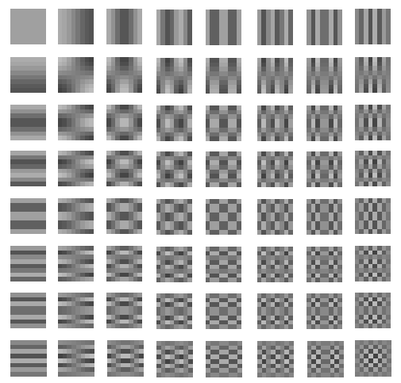
Discrete Cosine Transform
u
0 1 2 3 4 5 6 7
0 1 2 3 4 5 6 7
v
The 8x8 DCT basis

Slide 4
Discrete Cosine Transform
Example :
48 | 39 | 40 | 68 | 60 | 38 | 50 | 121
149 | 82 | 79 | 101 | 113 | 106 | 27 | 62
58 | 63 | 77 | 69 | 124 | 107 | 74 | 125
80 | 97 | 74 | 54 | 59 | 71 | 91 | 66
18 | 34 | 33 | 46 | 64 | 61 | 32 | 37
149 | 108 | 80 | 106 | 116 | 61 | 73 | 92
211 | 233 | 159 | 88 | 107 | 158 | 161 | 109
212 | 104 | 40 | 44 | 71 | 136 | 113 | 66
W
Y
H
the luminance of an image
8x8 values of luminance
DCT
699.25 | 43.18 | 55.25 | 72.11 | 24.00 | -25.51 | 11.21 | -4.14
-129.78 | -71.50 | -70.26 | -73.35 | 59.43 | -24.02 | 22.61 | -2.05
85.71 | 30.32 | 61.78 | 44.87 | 14.84 | 17.35 | 15.51 | -13.19
-40.81 | 10.17 | -17.53 | -55.81 | 30.50 | -2.28 | -21.00 | -1.26
-157.50 | -49.39 | 13.27 | -1.78 | -8.75 | 22.47 | -8.47 | -9.23
92.49 | -9.03 | 45.72 | -48.13 | -58.51 | -9.01 | -28.54 | 10.38
-53.09 | -62.97 | -3.49 | -19.62 | 56.09 | -2.25 | -3.28 | 11.91
-20.54 | -55.90 | -20.59 | -18.19 | -26.58 | -27.07 | 8.47 | 0.31
8x8 DCT coefficiences

Slide 5
Exercise
Apply DCT transform on the block in previous slide and verify results.
Apply DCT transform on different artificially created 8x8 blocks and examine the results.
Apply DCT transform on a few blocks in the Lena image that you choose at run time and examine the results. Do this on the RGB planes and also YUV planes.

